Slide 1
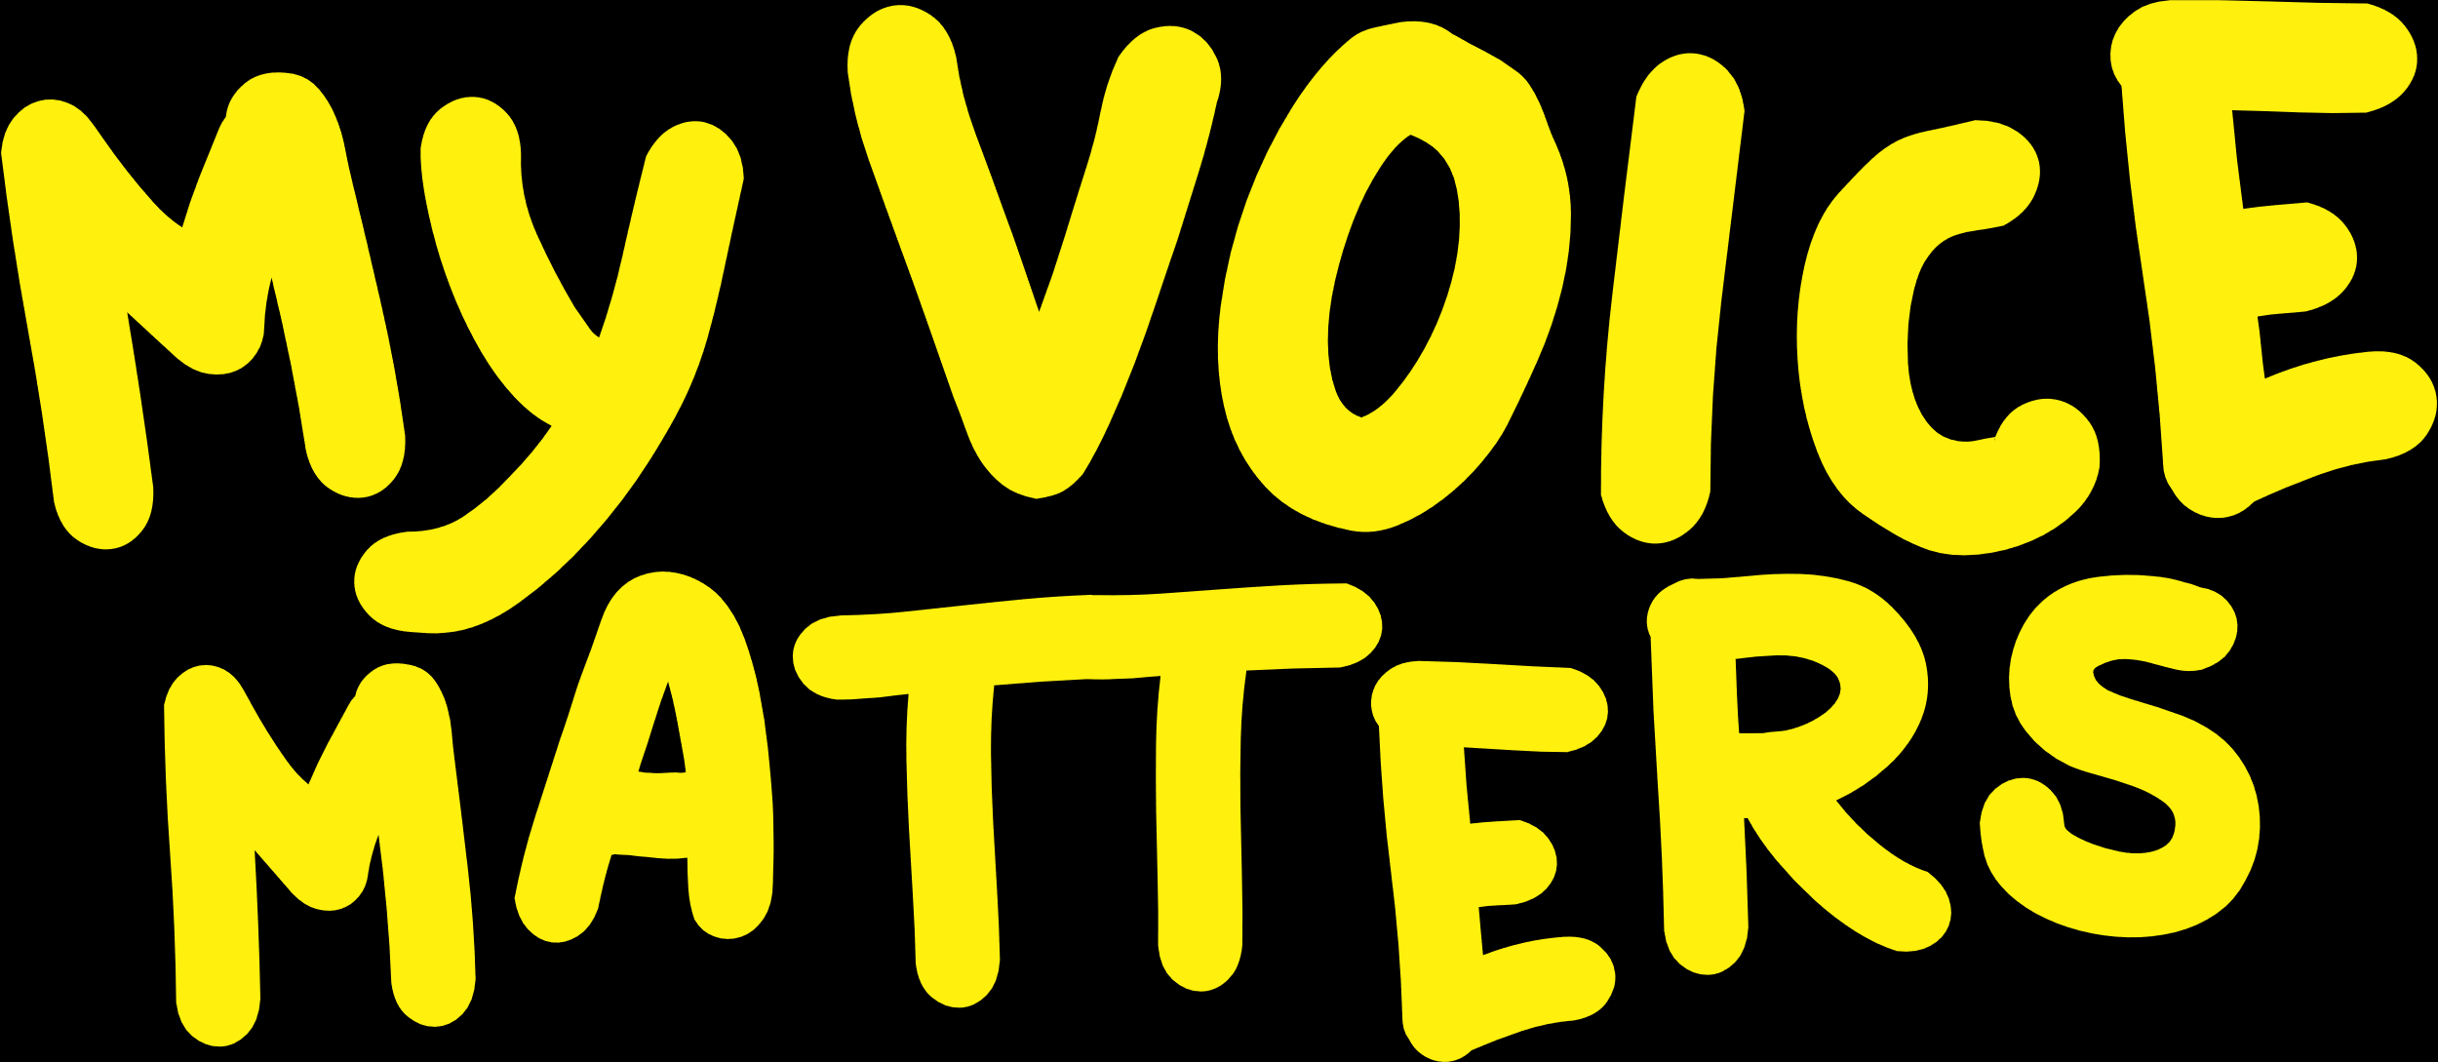
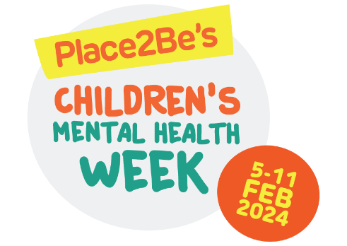
How well do we listen?
Briefing for school staff

Slide 2
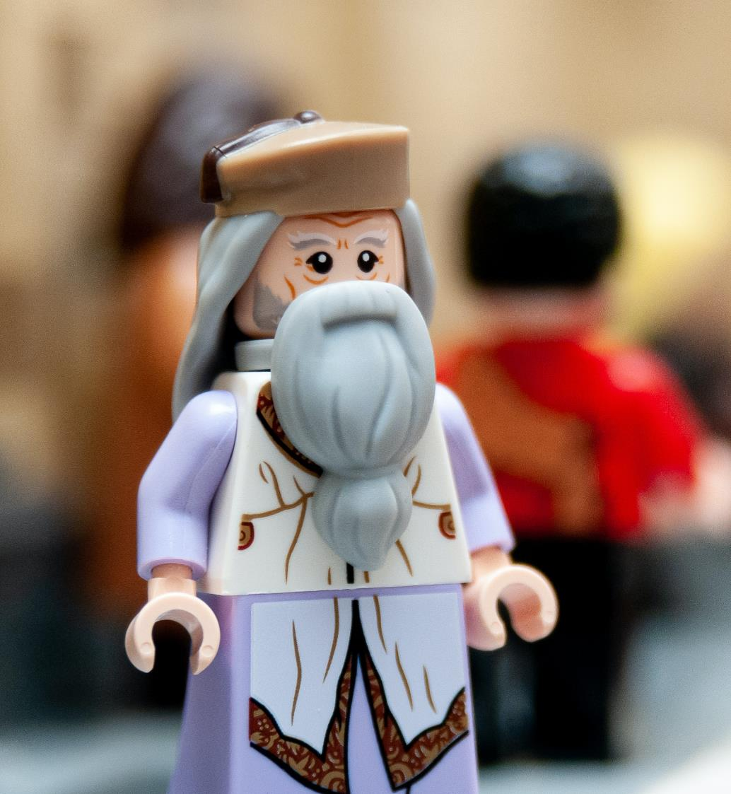


"A child’s voice, however honest and true, is meaningless to those who’ve forgotten how
to listen."
Professor Dumbledore

Slide 3
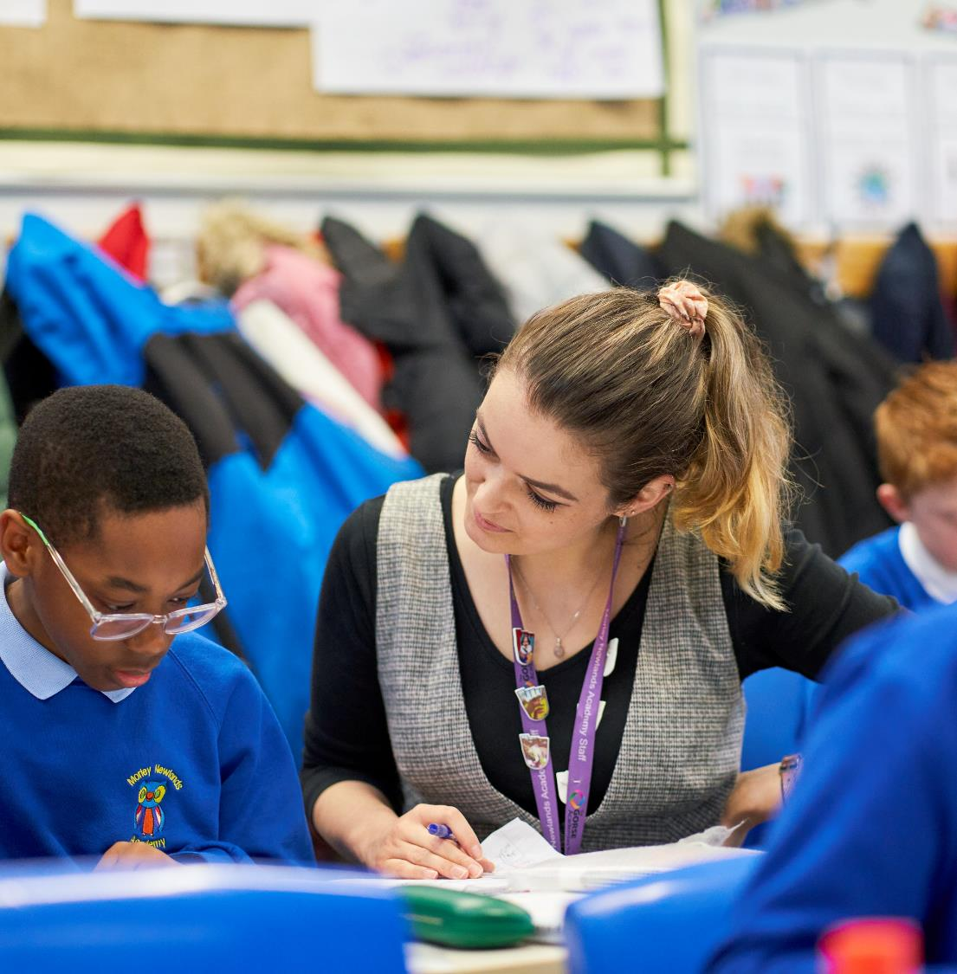
Group Discussion:
Why does this matter?

Slide 4
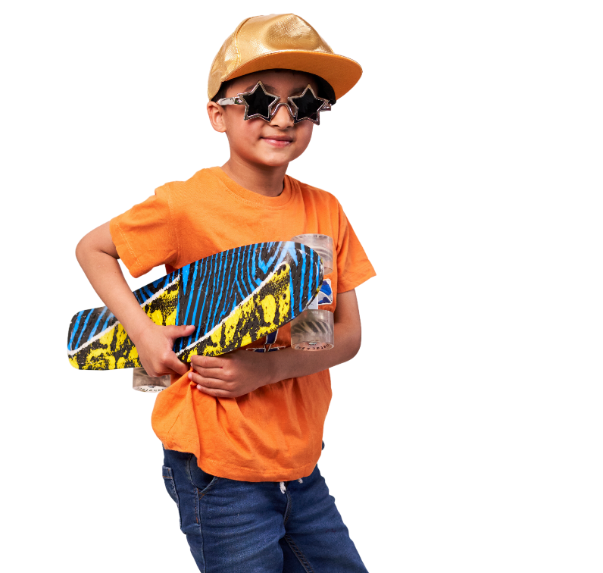
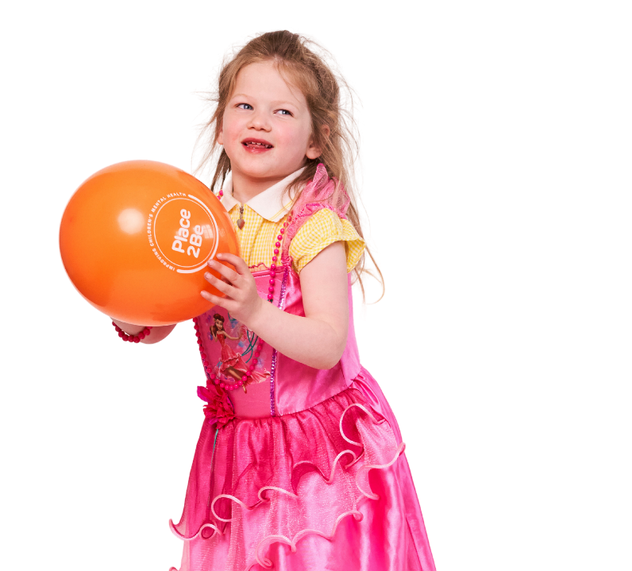
Article 12 UNCRC
Every child has the right to express their views, feelings and wishes in all matters affecting them, and to have their views considered and taken seriously.

Slide 5
Save the Children
“There is a growing body of evidence that routinely taking children’s views and experiences into account – within the family, at school and in other settings – helps develop children’s self-esteem, cognitive abilities, social skills and respect for others. Through participation, children acquire skills, build competence, extend aspirations and gain confidence. A virtuous circle is created. The more children participate, the more effective their contributions and the greater the impact on their development.”
A resource guide on the UN committee on the rights of the child general comment no.12, 2011

Slide 6
Save the Children
“Children acquire competence in direct relation to the scope available to them to exercise agency over their own lives. The most effective preparation for building self-confidence is to achieve a goal for oneself and not merely to observe someone else achieving that goal. Children who are highly marginalised find it very hard to achieve this on their own and need support through organised participation if they are to realise their potential.”
A resource guide on the UN committee on the rights of the child general comment no.12, 2011

Slide 7
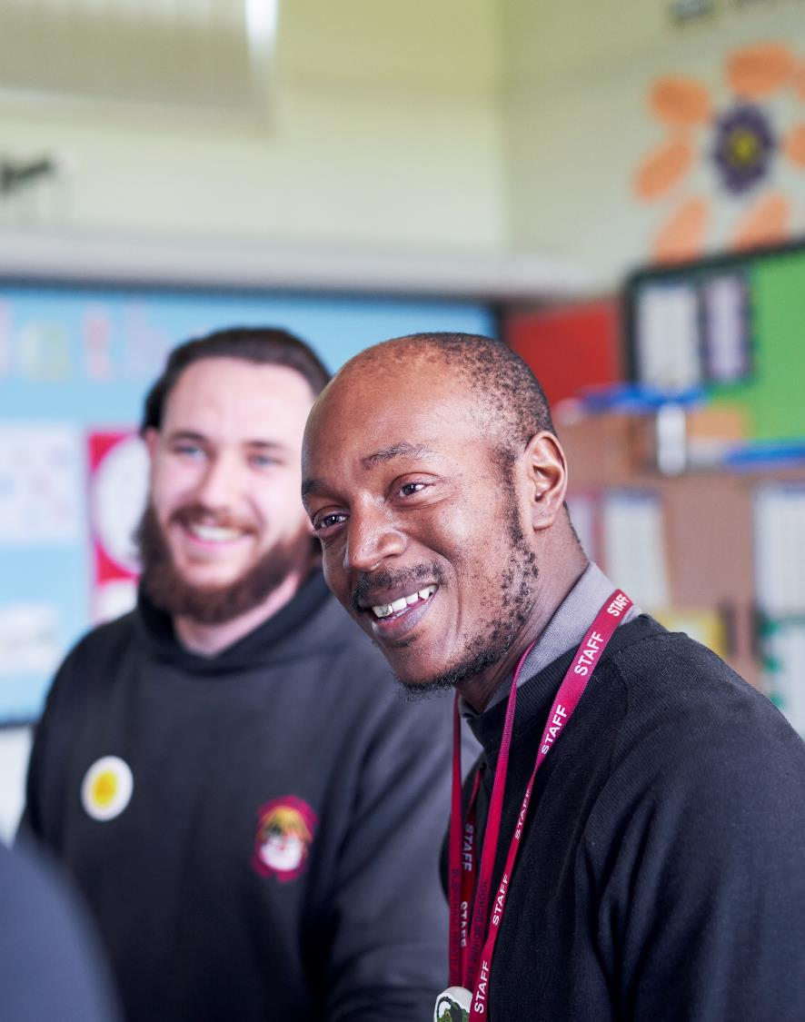
Group Discussion:
What are we already doing in our
school to support Article 12?

Slide 8
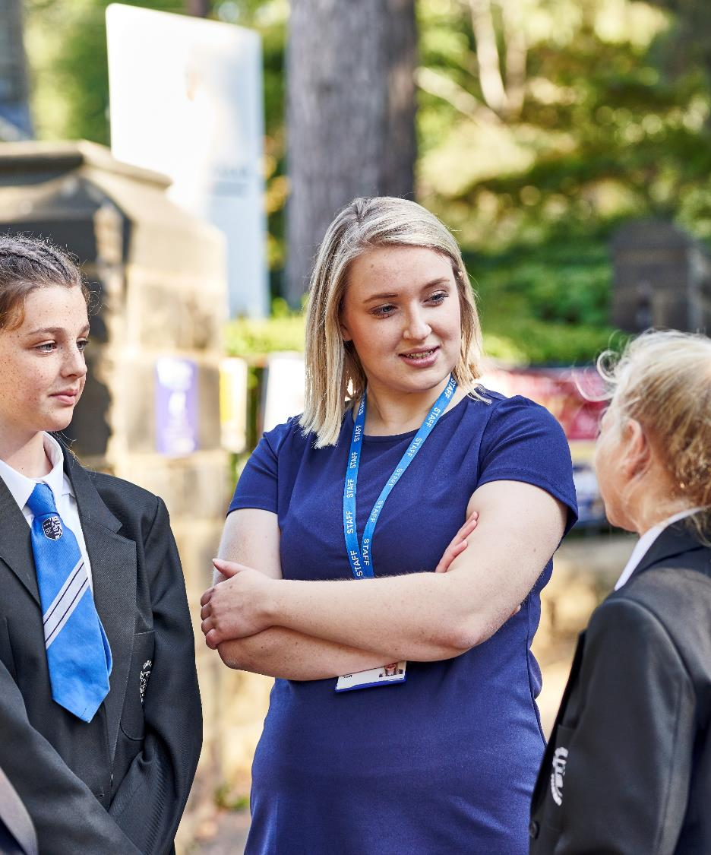
Group Discussion:
What are the barriers to listening
to a young person’s view?

Slide 9

Group discussion:
Where on the scale are you?
Children and young people know best
Adults know best
Notes:
Listening to children and young people's voices does not mean that our own adult wisdom, knowledge and judgements are completely suspended....

Slide 10
Some challenges
The power dynamic of adults and young people may mean there is no safe space for young people to express their views genuinely
There may be some issues about which children and young people are not considered capable e.g. healthcare
Listening to young people might not translate into actions influenced by their views
Adults have different views about the capacity of young people to be ‘rights holders with influence’

Slide 11
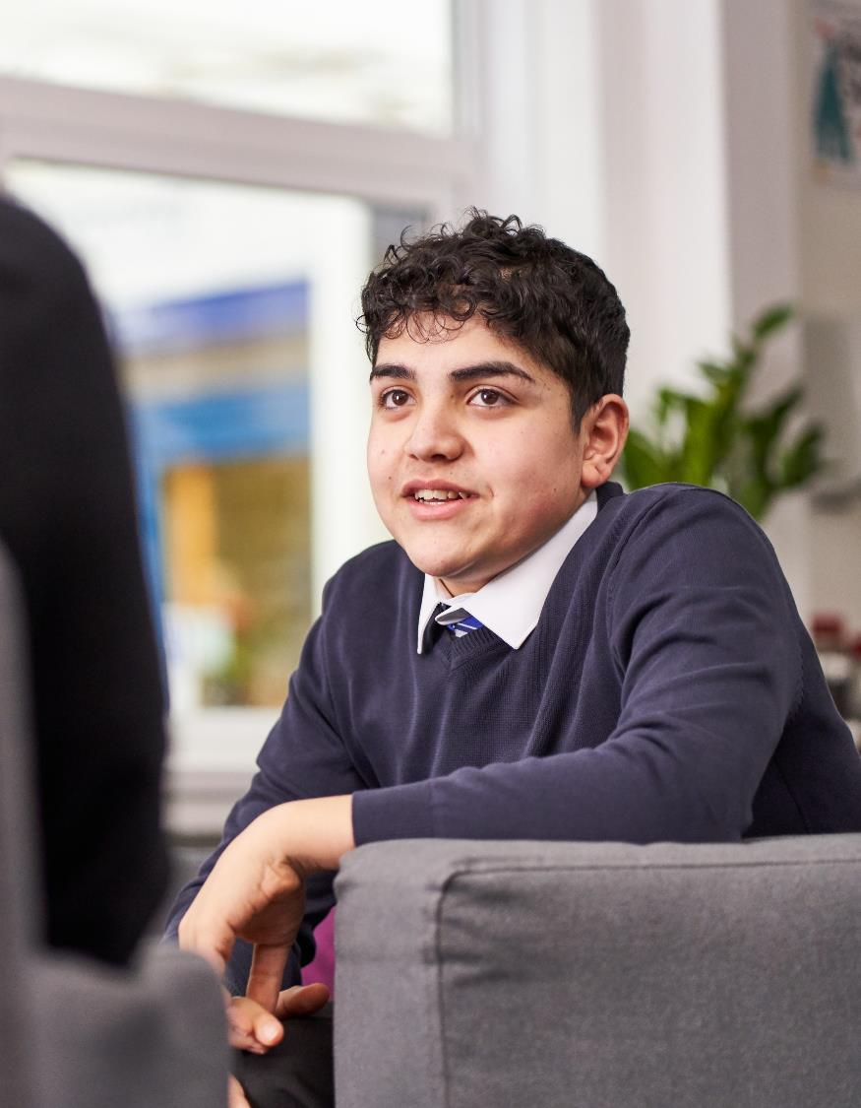
Group Discussion:
How can we better listen to
the views of young people?

Slide 12
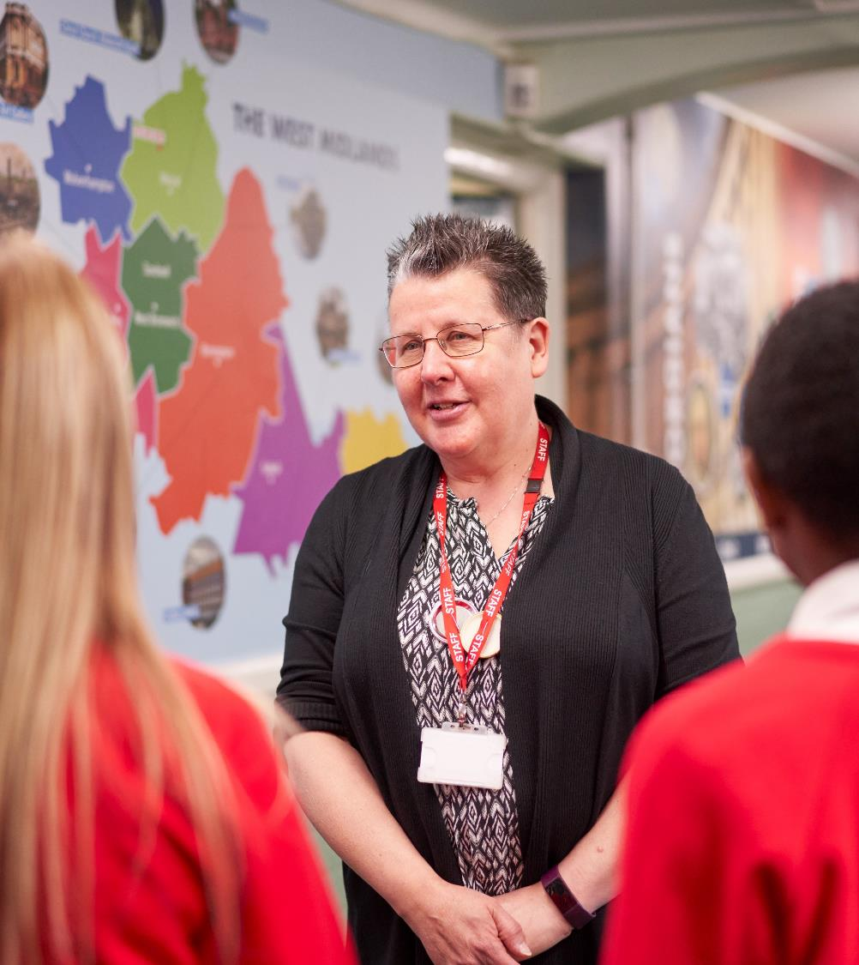
Group Discussion:
How could we act more effectively on the views
of our young people?
Notes:
For more ideas on effectively acting on the views of young people, take a look at the Welsh Government's self assessment tool: https://www.childcomwales.org.uk/wp-content/uploads/2022/03/TRW_Selfassessment_tool_ENG-1.pdf

